Slide 1
Wireless EV Charging Roads
Exploring the Future of Electric Vehicle Infrastructure and Technology

Slide 2
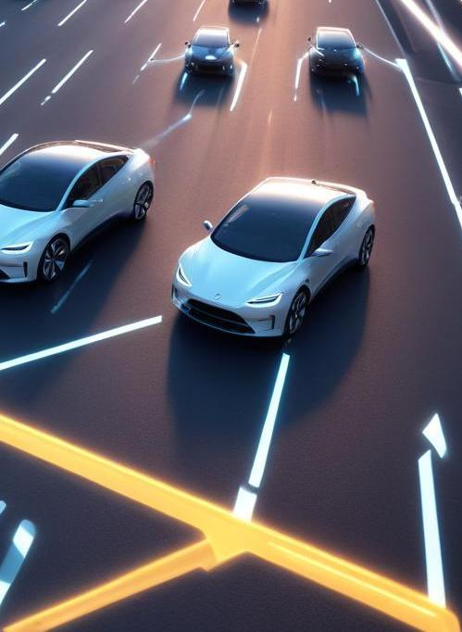
Introduction
This presentation discusses the concept of wireless electric vehicle (EV) charging roads, their implementation, and their significance in modern transportation systems.

Slide 3
Overview
01

Slide 4
Definition of wireless EV charging
Wireless EV charging uses electromagnetic fields to transfer energy from charging infrastructure to electric vehicles without physical connectors. This technology enhances convenience and improves the charging experience for EV users by allowing them to charge on the go, using specially designed roads or parking spaces.

Slide 5
Importance of EV charging infrastructure
Developing robust EV charging infrastructure is crucial for supporting the growing number of electric vehicles. Reliable charging options increase consumer confidence in EV adoption, reduce range anxiety, and promote the shift towards sustainable transportation. Wireless charging systems make it easier and more accessible for drivers to charge their vehicles, fostering a greener future.

Slide 6
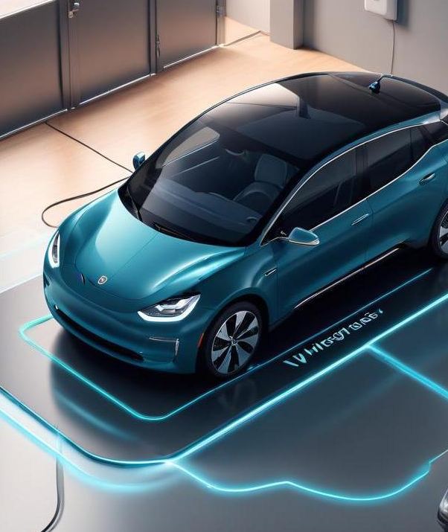
Technological advancements
Recent advancements in wireless EV charging technology include improvements in energy transfer efficiency, the development of high-power charging pads, and the integration of smart grid technologies. These innovations help support faster charging times, enhance safety, and reduce energy loss during the charging process. Moreover, ongoing research focuses on enhancing compatibility with different EV models and scaling the technology for broader infrastructure use.

Slide 7
02
Implementation

Slide 8

Design and construction of charging roads
The design and construction of charging roads involve embedding charging infrastructure beneath the road surface. Engineers must consider factors such as load-bearing capacities, environmental impact, and seamless integration with traffic systems. This approach requires collaboration between urban planners, civil engineers, and technology developers to ensure that the roads are safe, efficient, and environmentally friendly.

Slide 9
Integration with existing road systems
Integrating wireless charging technology with existing road systems poses challenges, including retrofitting current infrastructures and addressing the legalities of public space usage. Solutions typically involve phased approaches to construction and testing, ensuring minimal disruption to daily traffic. Additionally, technology must be compatible with various vehicle models to provide universal access.

Slide 10
Challenges and solutions in deployment
Challenges in deploying wireless EV charging roads include high initial costs, technological compatibility issues, and the need for substantial power sources. Solutions may involve public-private partnerships for funding, government incentives for infrastructure development, and gradual implementation to evaluate effectiveness. Community engagement and education are also vital for addressing public concerns and ensuring successful adoption.

Slide 11
Conclusions
Wireless EV charging roads represent a significant advancement in electric vehicle infrastructure, offering convenience and sustainability. By addressing the challenges of integration and deployment, communities can unlock the full potential of electric transportation, paving the way for a greener future.

Slide 12
Thank you!
Do you have any questions?
+91 620 421 838

